Slide 1







Technology Trend and the future skill requirements
Adriana Alonso
July 2022

Slide 2



OUTLINE
Executive Summary
Introduction
Methodology
Results
Visualization – Charts
Dashboard
Discussion
Findings & Implications
Conclusion
Appendix

Slide 3

EXECUTIVE SUMMARY
Top Programming language skills
Current Technology Usage
Language Worked
Databases
Platforms
Future Technology Trend
Demographic Technology
Respondent classified
Gender
Country
Age
Education Level

Slide 4

INTRODUCTION
Analyzing Technology Trend
The Top Programming Languages demand
The Top Databases Skills
The popular IDEs
The Future Technology Trends

Slide 5

METHODOLOGY
Collecting Data
Exploring Data
Data Cleaning
Normalizing Data
Data Visualization
Presentation

Slide 6
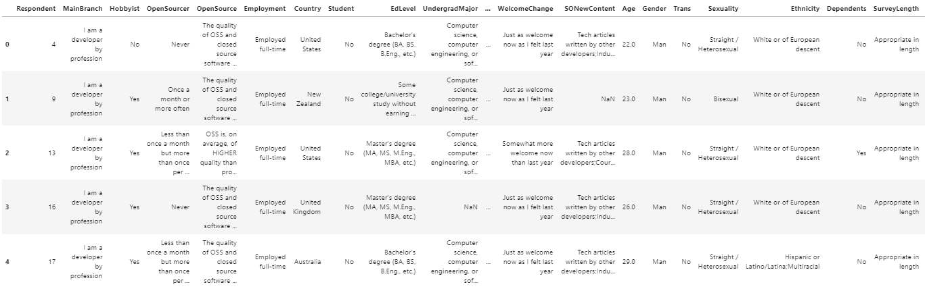
Collecting Data / Exploring Data
dataset_url = https://cf-courses-data.s3.us.cloud-object-storage.appdomain.cloud/IBM-DA0321EN-SkillsNetwork/LargeData/

Slide 7
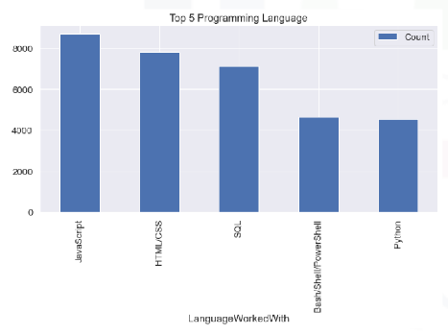
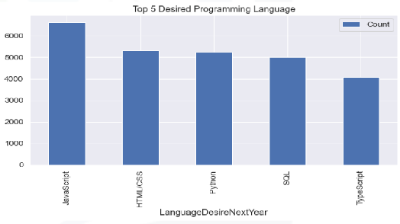
PROGRAMMING LANGUAGE TRENDS
Current Year
Next Year

Slide 8
PROGRAMMING LANGUAGE TRENDS - FINDINGS & IMPLICATIONS
Findings
JavaScript is the top 1 this year
SQL continues popular programming language
Python become more popular next year
Implications
Language Programming have high demand
Companies need high performant in language programming to development of their strategies.

Slide 9
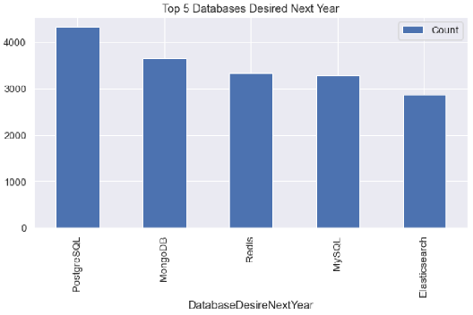
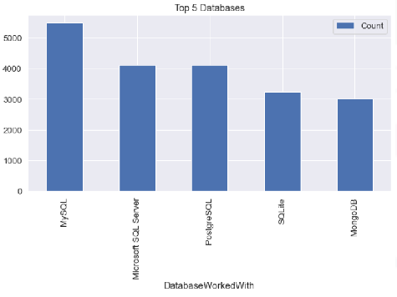
DATABASE TRENDS
Current Year
Next Year

Slide 10
DATABASE TRENDS - FINDINGS & IMPLICATIONS
Findings
MySQL is the top 1 this Year
MongoDB are upcoming favorites
Elasticsearch will be a new trend.
Implications
SQL is a database preferable by the companies
A very competitive future is visualized when the new data trens.

Slide 11

DASHBOARD
GITHUB
https://github.com/AALONSO19/Data-Wrangling-Lab

Slide 12
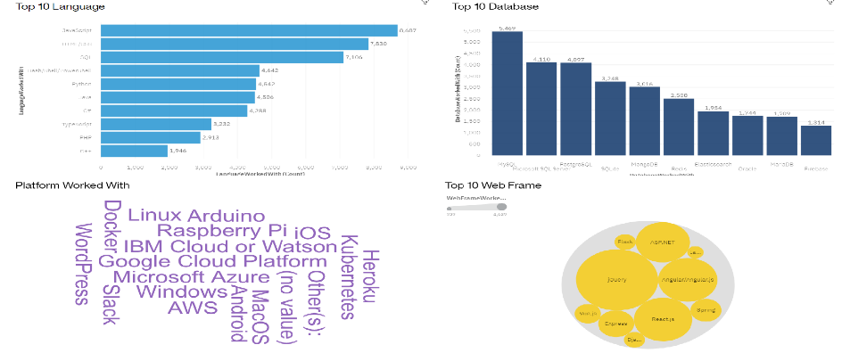
DASHBOARD TAB 1
Screenshot of dashboard tab 1 goes here

Slide 13
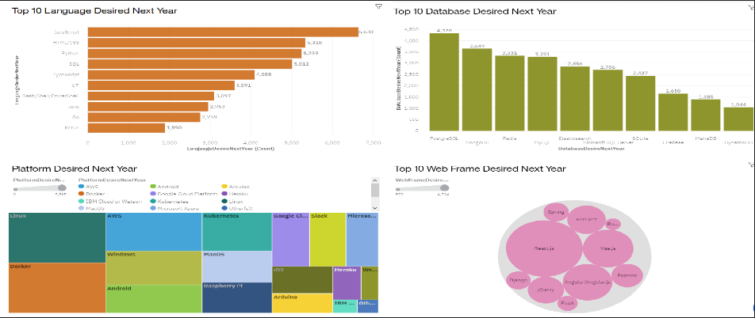
DASHBOARD TAB 2

Slide 14
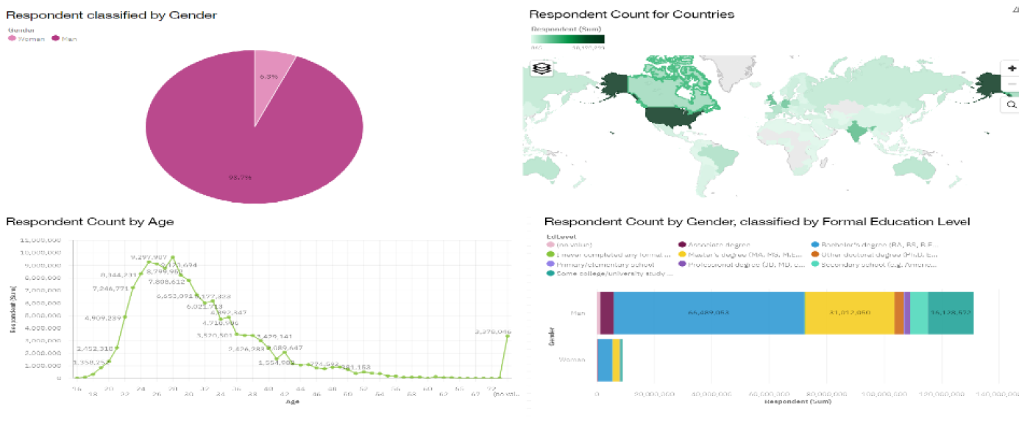
DASHBOARD TAB 3

Slide 15
DISCUSSION
Gender participation Technology field
Education Level influence in participation

Slide 16
OVERALL FINDINGS & IMPLICATIONS
Findings
Trending Technology
Technology Trend in countries
News Technology Platform are coming
Gender and Educational Level in Technology
Implications
The importance of staying update in technology application
The importance of applying new technology in companies
Underdeveloped countries should invest more in new technology

Slide 17

CONCLUSION
Python, the fastest-growing major programming language, has risen in the ranks of programming languages in our survey yet again, edging out Java this year and standing as the second most loved language
Over half of respondents had written their first line of code by the time they were sixteen, although this experience varies by country and by gender.

Slide 18
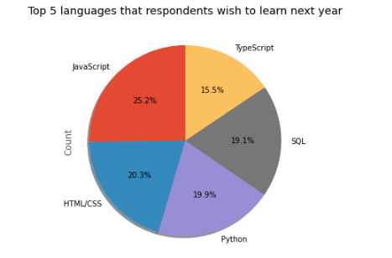

APPENDIX

Slide 19
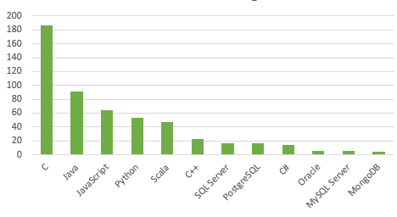
JOB POSTINGS

Slide 20
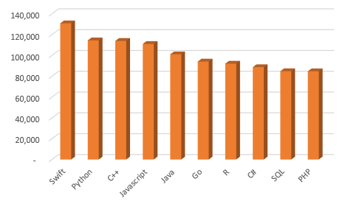
POPULAR LANGUAGES

